Slide 1

Insights into Domain Names and Product Categories of e-Commerce Websites: A Case Study of the UAE
Rachidatou Ingrid Traoret
Salama AlDhaheri
Fatima AlAmeemi
Dr. Gurdal Ertek

Slide 2


Overview
Introduction
Problem statement
Data
Methodology
Results
Conclusion
Contributions
Future work
2
Notes:
All Images credit: Canva.com

Slide 3


Introduction
In 2020, the e-commerce retail sector, accounting for 18% of global retail sales and is expected to represent approximately 22% of global retail sales by 2024.
In 2022, the disparity in growth between e-commerce and traditional retail was minimal, with only a marginal difference of 0.2%, highlighting consumers' strong inclination towards online shopping
The global e-commerce market is expected to reach a total value $5.56 trillion by 2027
3
Notes:
All Images credit: Canva.com

Slide 4

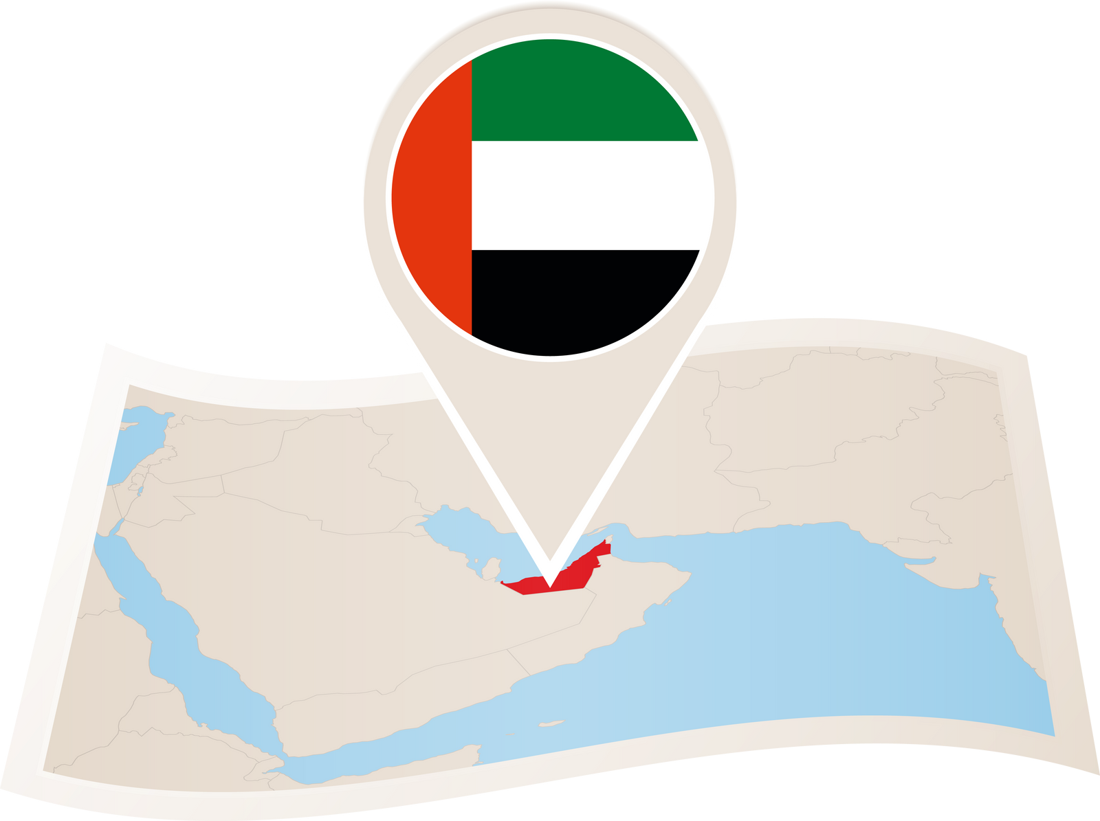
Introduction
Across the Middle East and North Africa (MENA) region, 91% of consumers make online purchases, and 70% prefer digital payment methods
The e-commerce sector in the Middle East is expected to achieve a market volume of US$50 billion by 2025.
Previous studies have highlighted the growth potential and dynamics of e-commerce in the UAE, emphasizing the importance of understanding the underlying factors that contribute to the success of online platforms
UAE is positioned as the 27th largest e-commerce market in the world and is anticipated to generate revenue of approximately US$10,205.5 million by the year 2023
4
Notes:
All Images credit: Canva.com

Slide 5


Problem Statement
Objective: Conduct a comprehensive analysis of the top 10,000 e-commerce websites operating in the UAE, examining aspects such as domain-naming patterns and product categories.
To the best of our knowledge, the present study is the first of its kind, by presenting a methodology and sample country-specific analysis.
Can guide two critical strategic planning problems that every e-commerce start-up across the globe faces:
What should be our domain name?
Which product categories should we offer?
5
Notes:
All Images credit: Canva.com

Slide 6
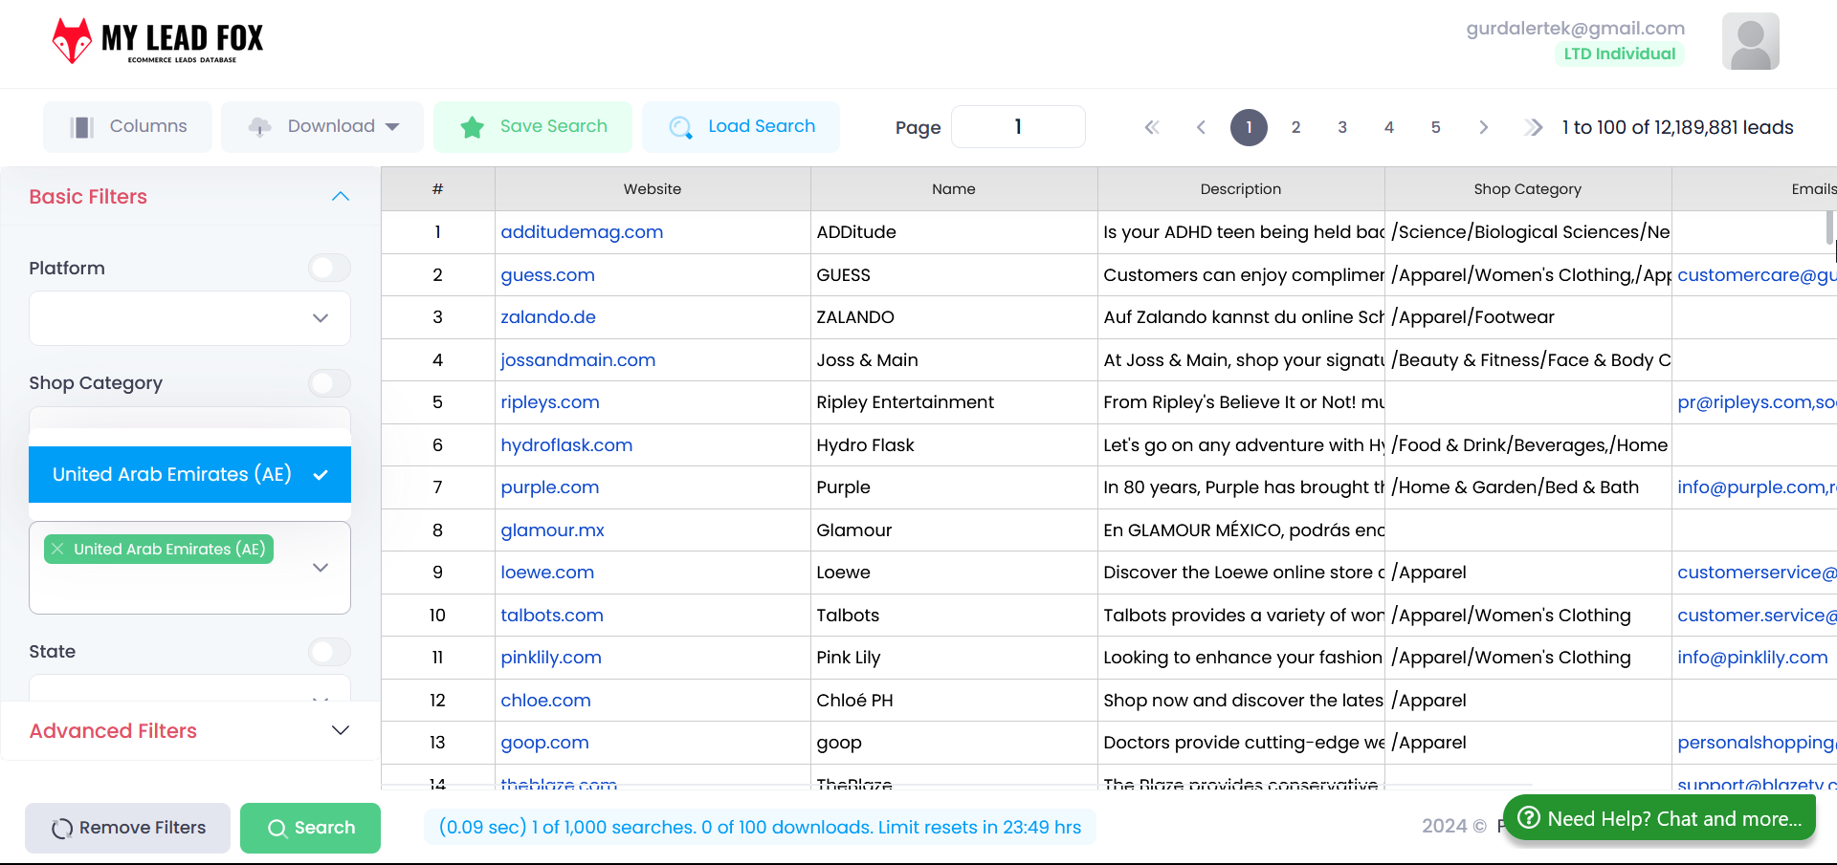
Source Data

Slide 7
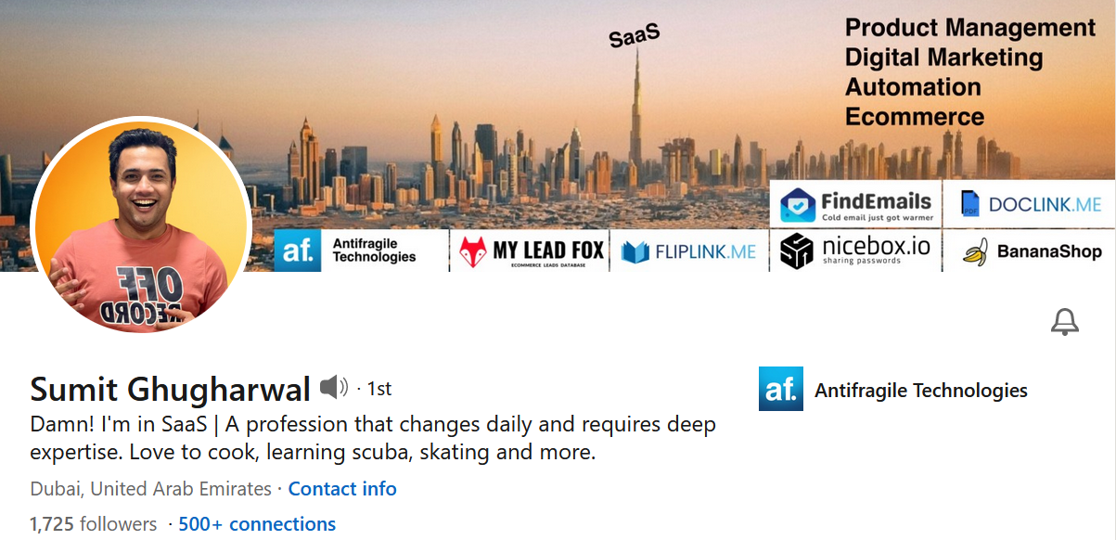
Source Data
MY LEAD FOX | Dubai based Data Provider | Life-Time Access to the Platform through AppSumo
| Permission granted from the Founder
7

Slide 8
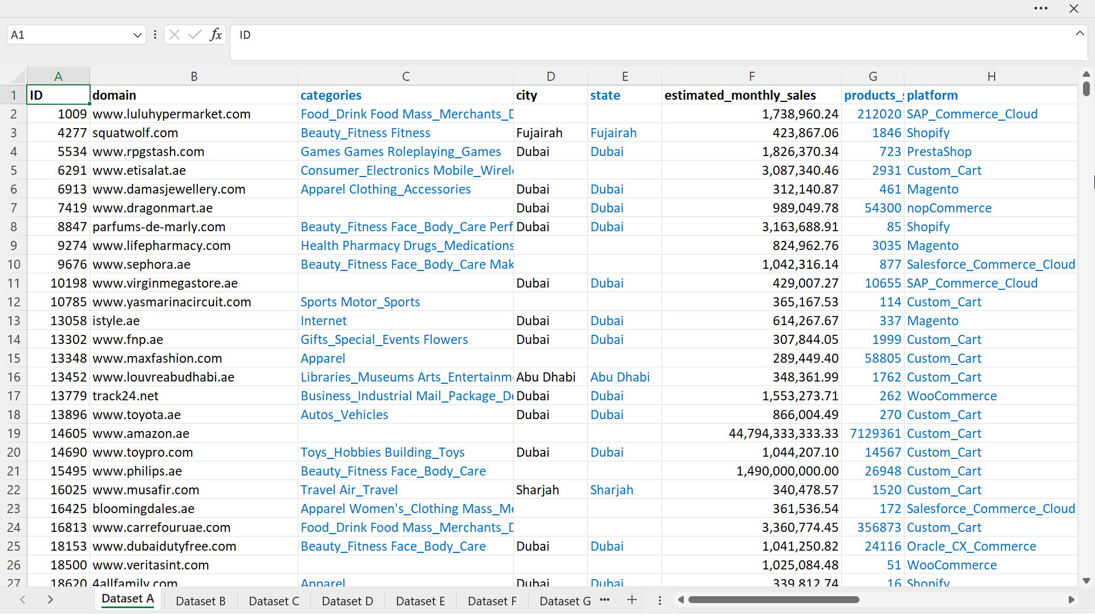
Source Dataset A & Derived Datasets B ... G
8

Slide 9
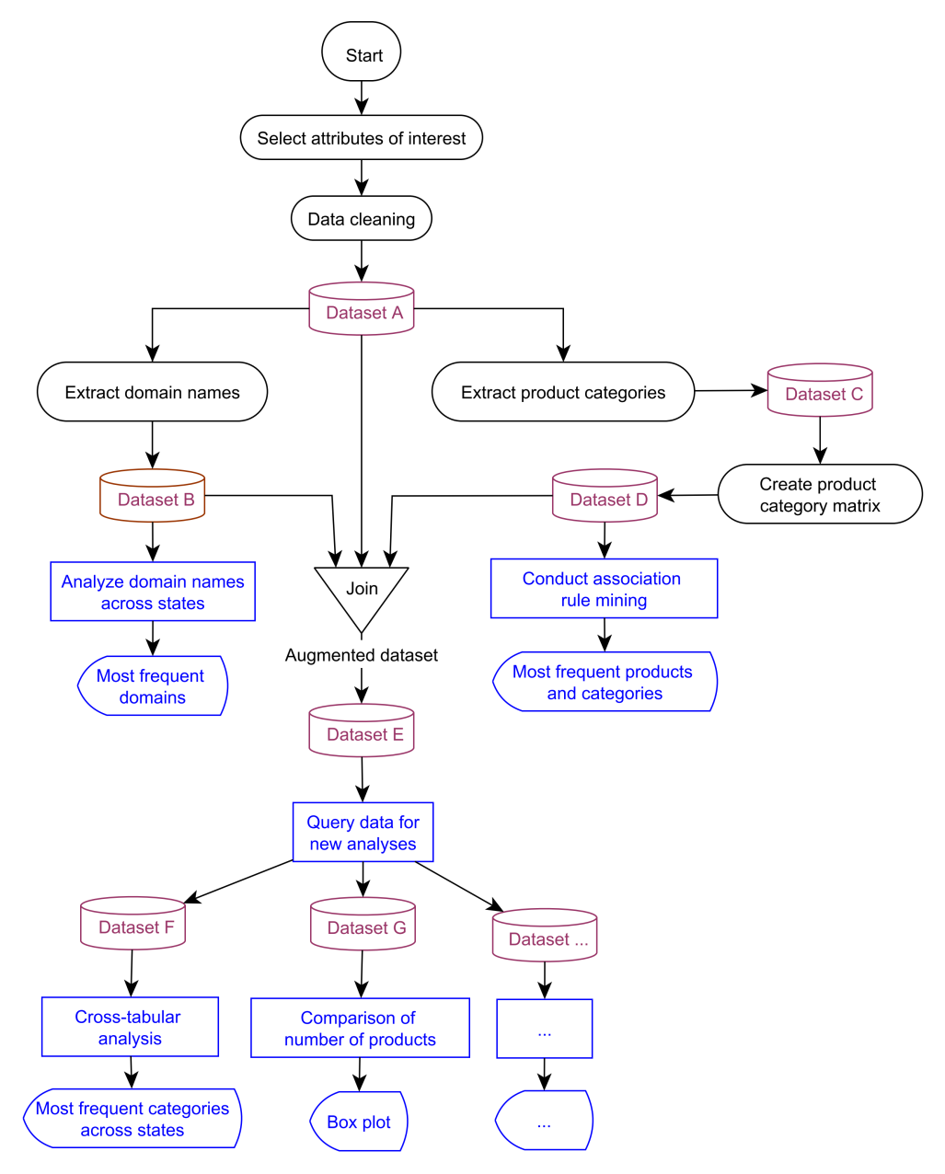

Methodology
9
Notes:
All Images credit: Canva.com

Slide 10
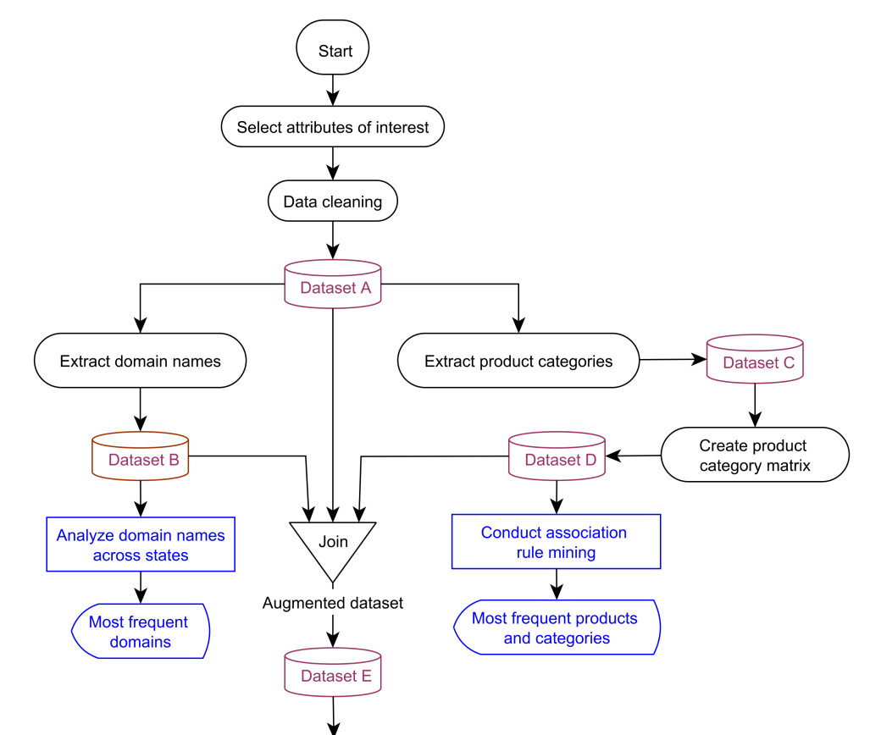
Methodology
10
Notes:
All Images credit: Canva.com

Slide 11
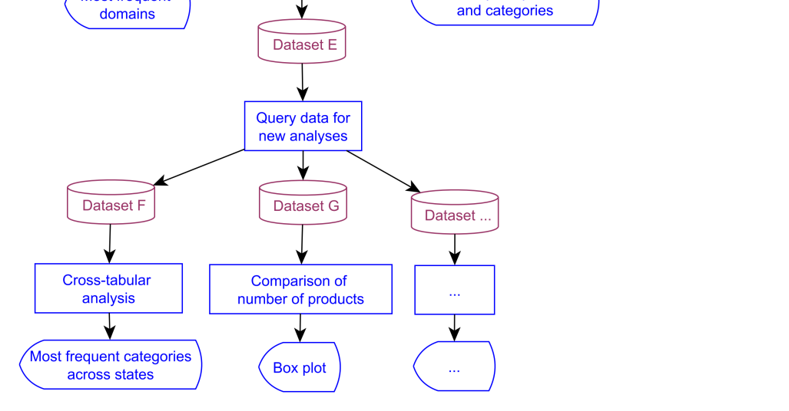
Methodology
11
Notes:
All Images credit: Canva.com

Slide 12
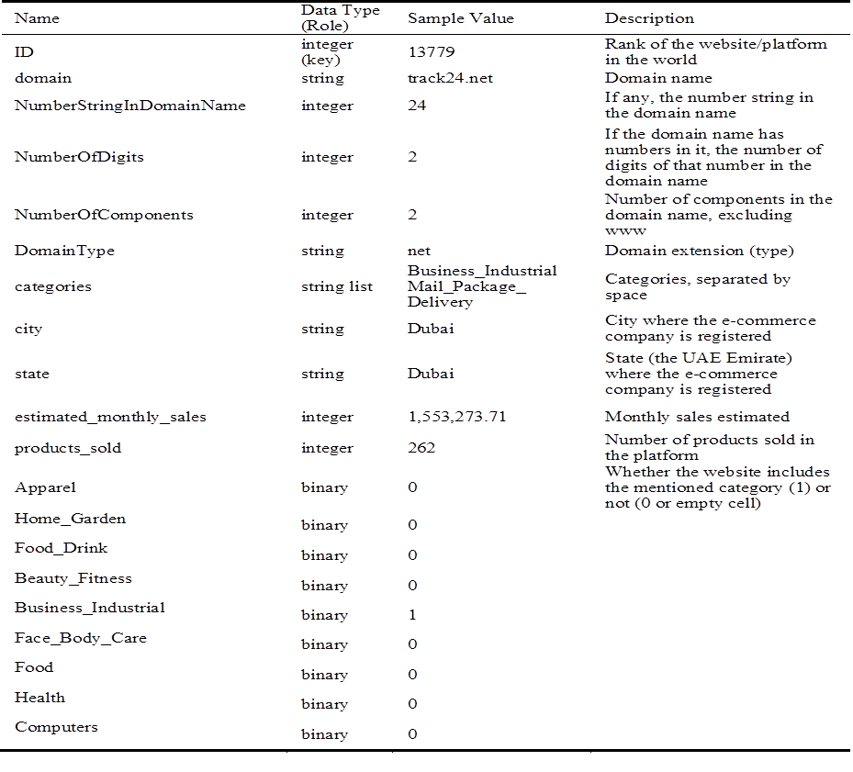
Dataset E
Table 1. Data attributes in Dataset E that were the focus of the presented research.
12

Slide 13
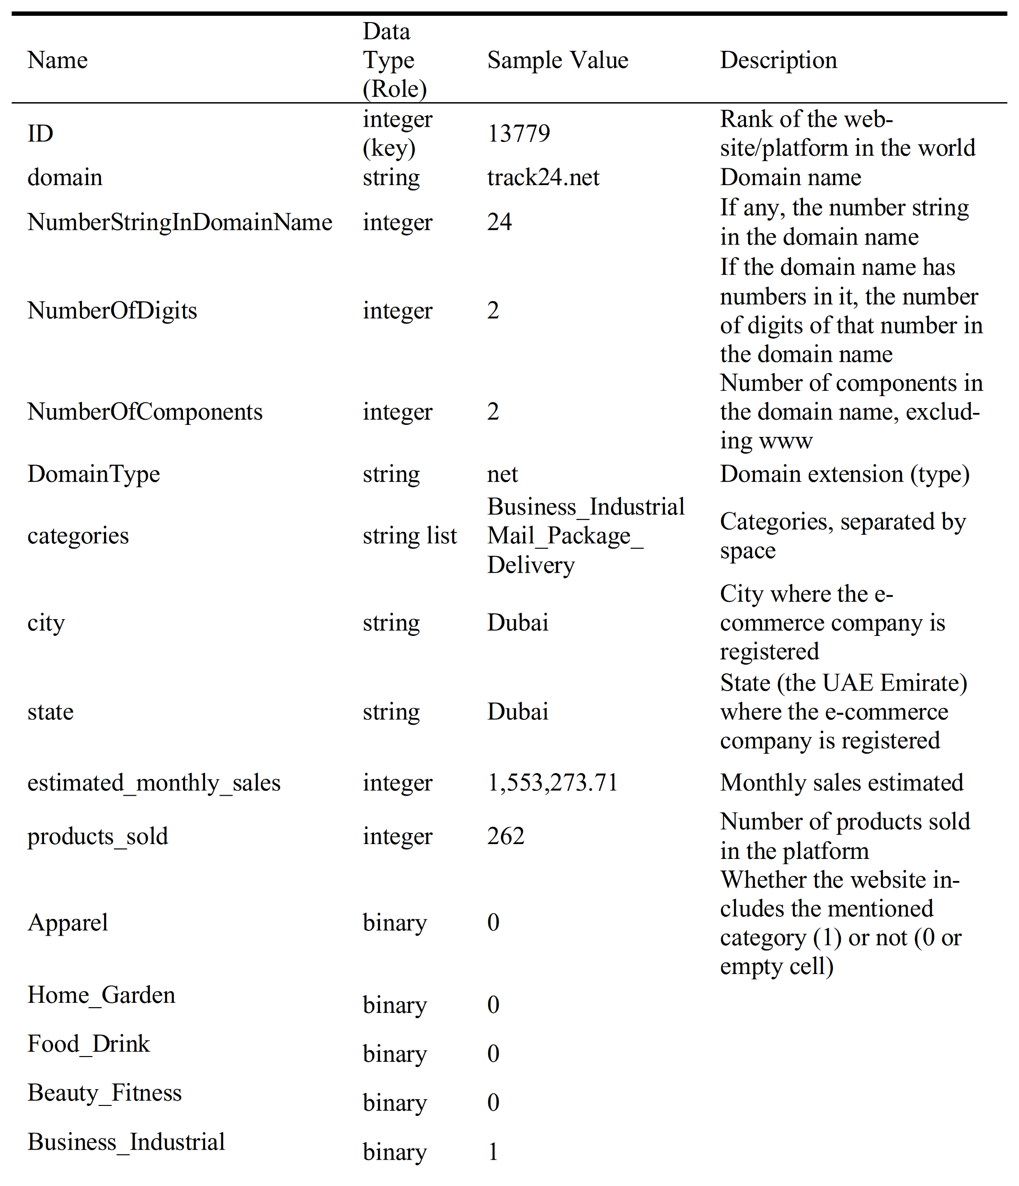
Dataset E
13

Slide 14

Dataset E
14

Slide 15


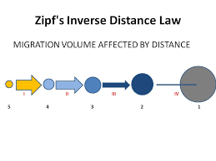
Results
Domain Extension Distribution
Table 2. Most frequent domain types
15

Slide 16
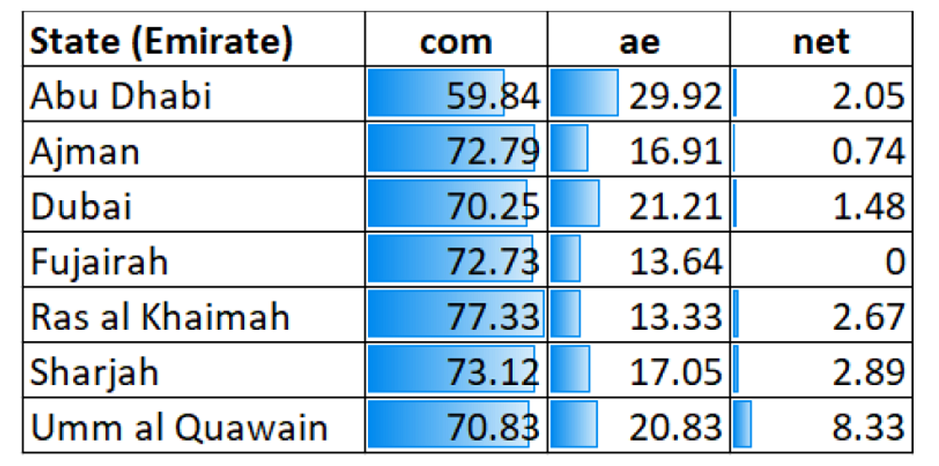
Results
Domain Extension Distribution
16

Slide 17
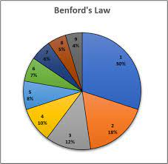
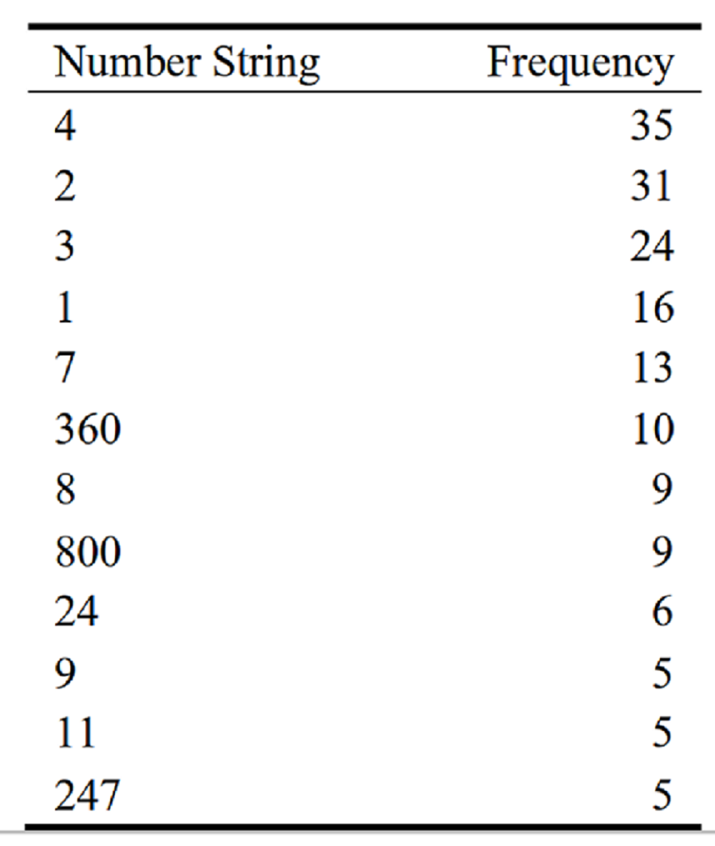
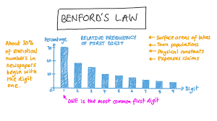

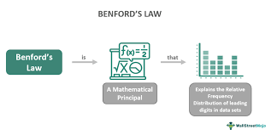
Results
Numeric Strings in Domain Names
Table 3. Most frequent digits in domain names.
17

Slide 18




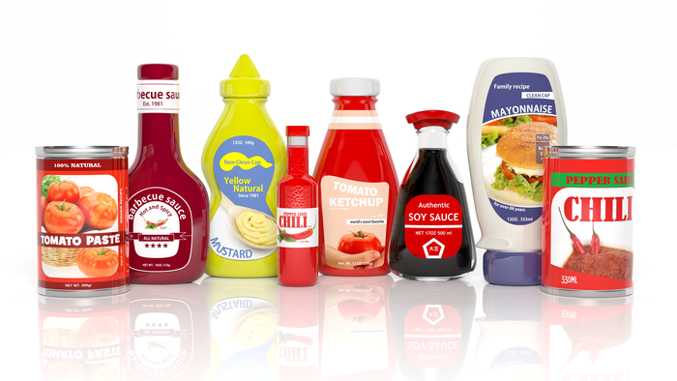




Results
Frequent Product Categories
Which categories are most frequenly offered?
Which category combinations are offered together?
Conducted with Orange Software
https://orangedatamining.com
18
Notes:
All Images credit: Canva.com

Slide 19
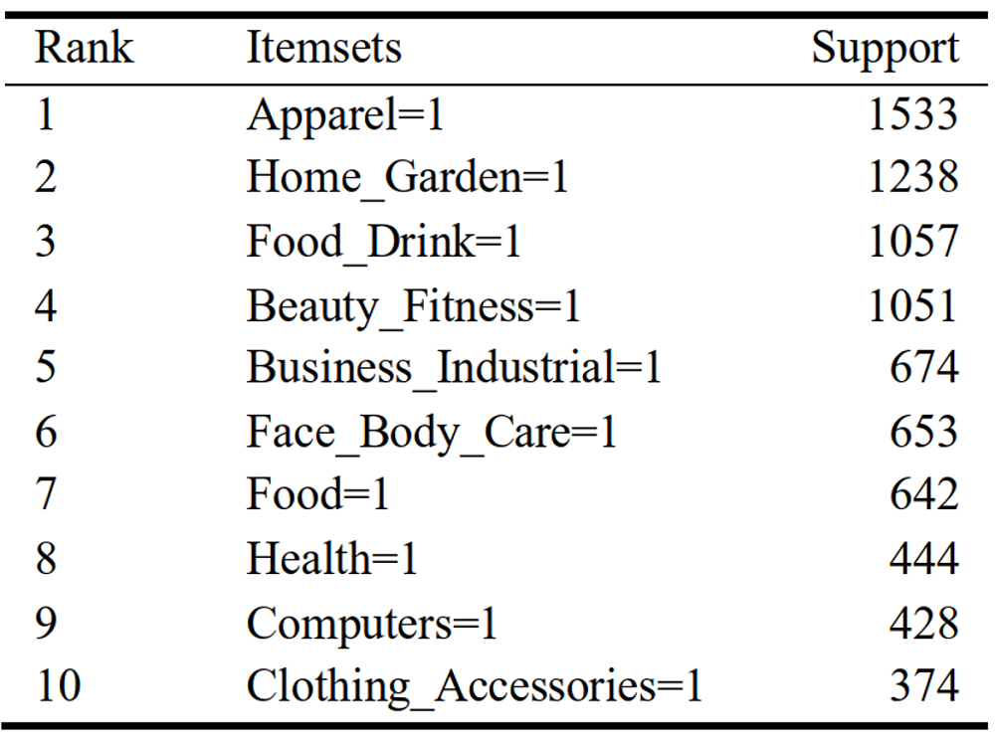
Results
Frequent Product Categories
Table 4. Top ten most frequent categories.
19
Notes:
All Images credit: Canva.com

Slide 20
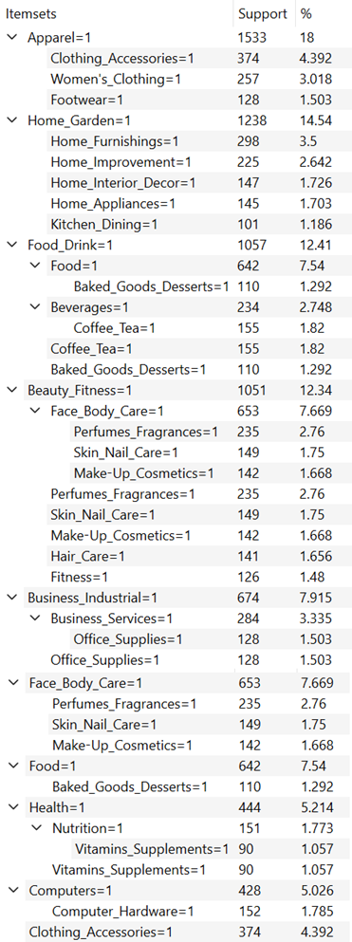
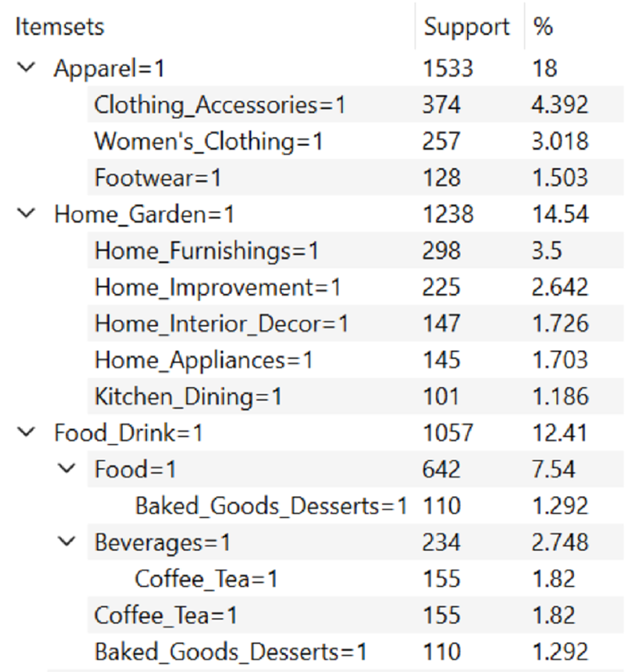

Results
Frequent Product Category Combinations
Fig. 3. Expanded view of the most frequent categories and category combinations
20

Slide 21
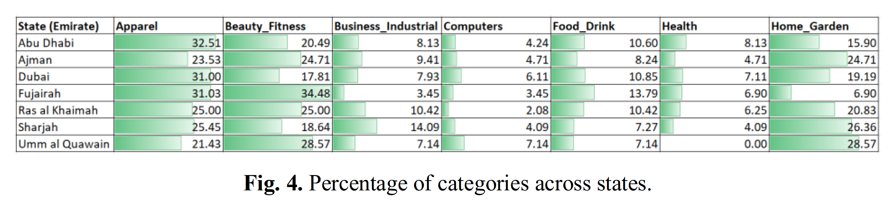

Results
Frequent Product Categories Across Emirates (States)
Fig. 4. Percentage of categories across the Emirates (states) of the UAE
21
Notes:
All Images credit: Canva.com

Slide 22

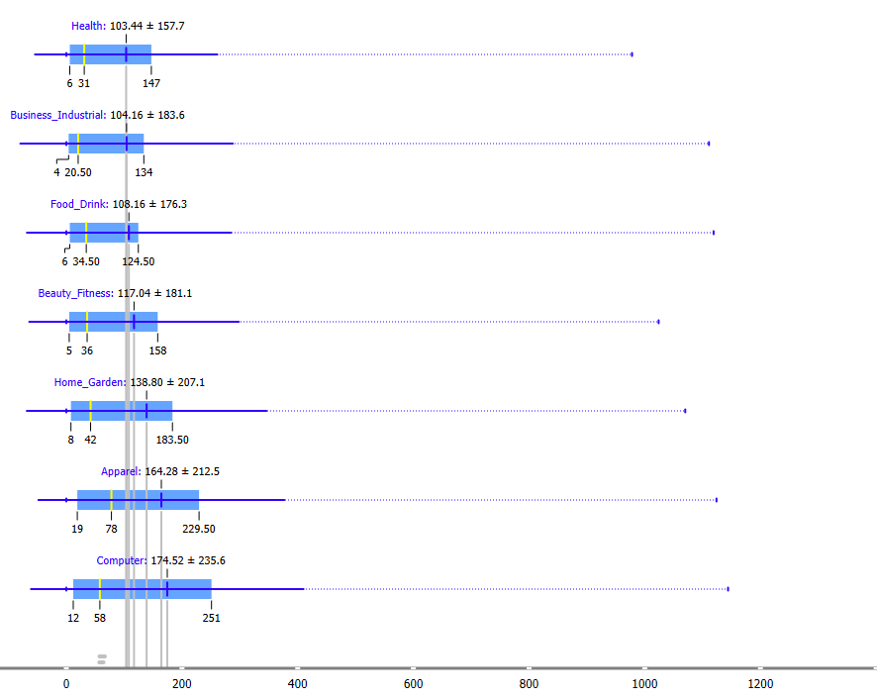
Results
Number of products sold on e-commerce websites vs. product categories
Fig. 5. Distribution of number of products sold, in relation to product categories
22

Slide 23

Conclusion
The findings reveal key patterns and relationships that can empower businesses to make data-driven decisions about branding, product offerings, and marketing strategies tailored to consumer preferences.
For instance, the prevalence of ‘. com’ and ‘.ae’ domains point to an opportunity for international and localized branding approaches.
The high frequency of apparel and home products guides strategic prioritization of offerings and inventory planning.
Meanwhile, insights into sub-categories and recurring itemsets provide a granular view of demand patterns to inform targeted promotions.
23
Notes:
All Images credit: Canva.com

Slide 24
Contributions
This study equips businesses with pivotal insights to gain a competitive edge.
The study also establishes a methodological blueprint for similar analytical projects in any e-commerce market, inspiring more evidence-based research on e-commerce.
Can guide two critical strategic planning problems that every e-commerce start-up across the globe faces:
What should be our domain name?
Which product categories should we offer?
24
Notes:
All Images credit: Canva.com

Slide 25


Future Work
First, augmenting the dataset with additional parameters, such as pricing, ratings, and reviews, can reveal crucial factors influencing purchase conversions
Second, a comparative analysis across e-commerce platforms and demographics can highlight the preferences of diverse consumer segments
Moreover, integrating temporal variables can uncover seasonal and event-based spikes, guiding inventory and delivery management to better satisfy customers and increase retention and sales.
25
Notes:
All Images credit: Canva.com

Slide 26
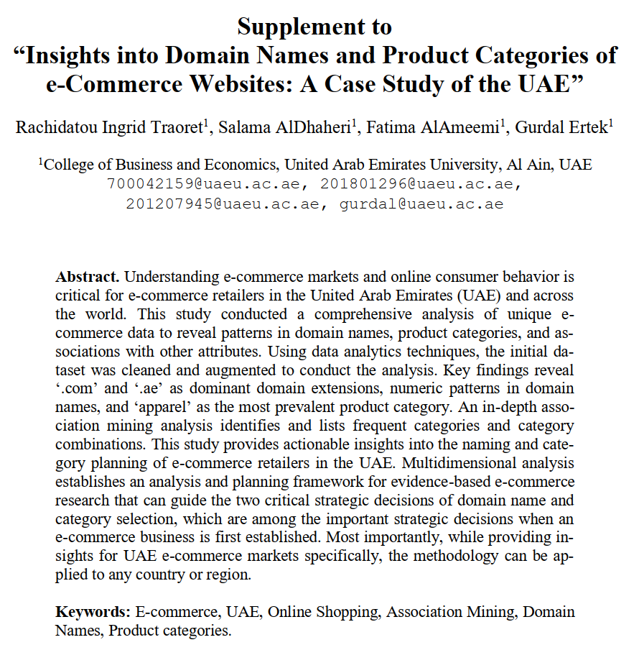
Supplement
10 pages
Detailed Literature Review
Additional Data Analysis
35+ References
All Datasets A…G
Orange Model (*.ows)
https://ertekprojects.com/ftp/supp/20.zip
26
Notes:
All Images credit: Canva.com

Slide 27



Thank You! Any Question?
Notes:
All Images credit: Canva.com

Slide 28
Insights into Domain Names and Product Categories of e-Commerce Websites: A Case Study of the UAE
Rachidatou Ingrid Traoret
Salama AlDhaheri
Fatima AlAmeemi
Dr. Gurdal Ertek

